Slide 1
Project Proposal
Henok Bekele
Jacob Anderson

Slide 2
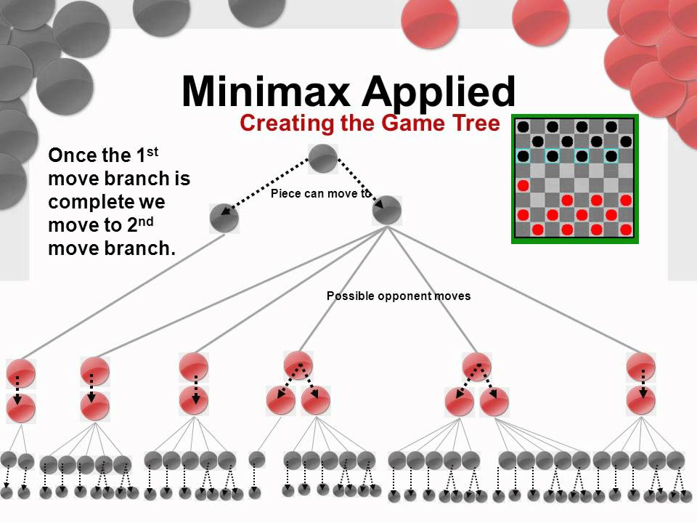
Introduction
We will be developing a checkers game that utilizes a threaded minimaxing search algorithm as the opposing A.I.

Slide 3
Technology
We are implementing a GUI that allows players to control the game
We want to add a difficulty selector that will ultimately change the number of moves considered by the algorithm, making it easier/harder depending on the selector.
Tracking the number of moves considered by the algorithm and display that number to the user
This will be coded in either c++

Slide 4
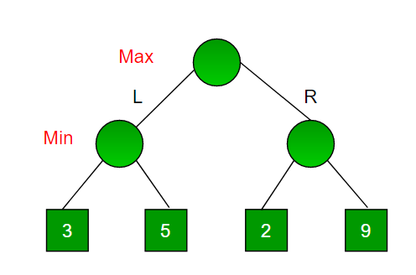
Algorithm/Threading
Every board space will be assigned a value based on where the players checker pieces are
The A.I will be looking to achieve the highest score possible while also considering your next move to be the most minimal value achievable.
Through threading, we want the algorithm to be considering all of these moves simultaneously
(Potential race condition for tracking the number of moves considered?)
Source: https://www.geeksforgeeks.org/minimax-algorithm-in-game-theory-set-1-introduction/

Slide 5
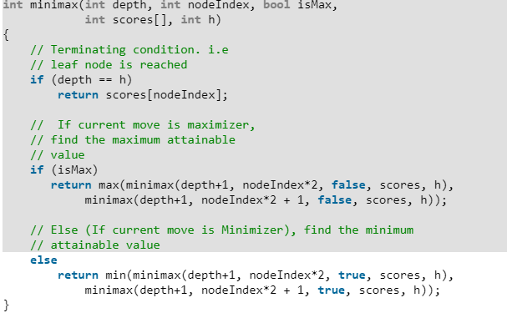
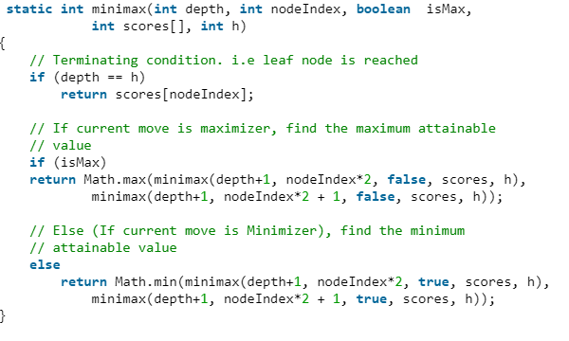
C++
Java

Slide 6
Goals
We know we did a good job if our code is able to execute and allow the player to interact with the game and play against the computer.
The difficulty selector properly changes the number of moves considered
The number of moves considered displays correctly

Slide 7
The End

